Slide 1
Reflex Game

Slide 2



communication
Messenger
Trello
Github

Slide 3


Wireframe

Slide 4
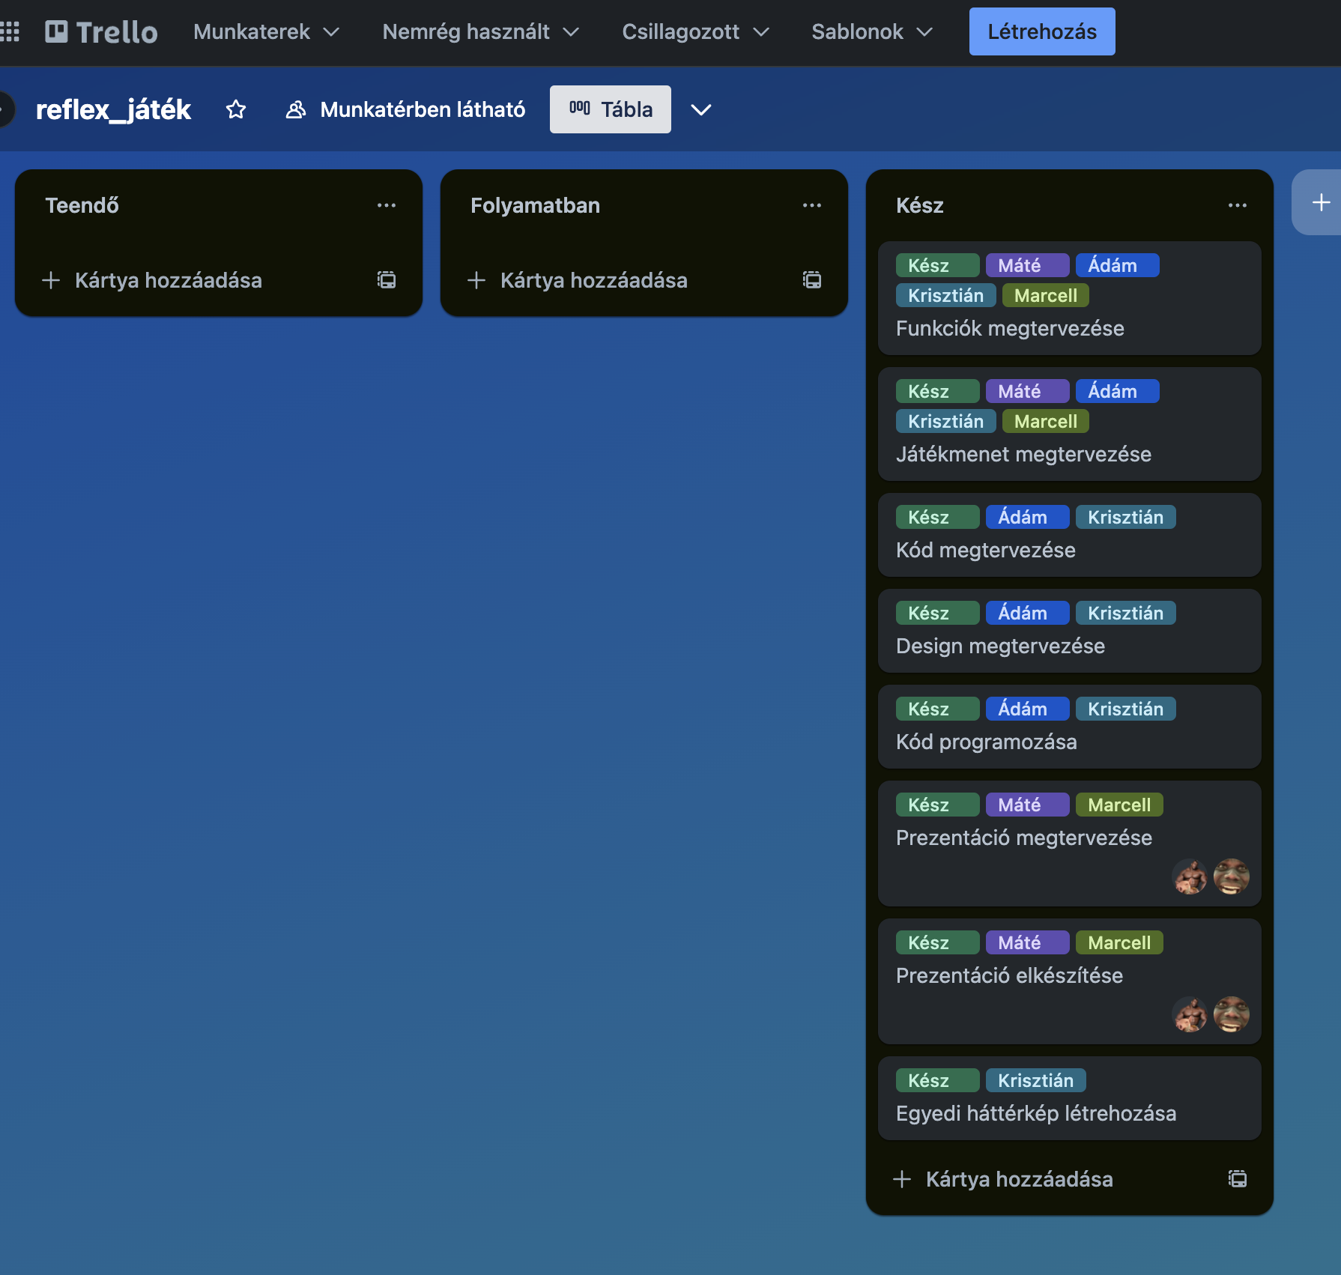
TRELLO WORKSPACE

Slide 5
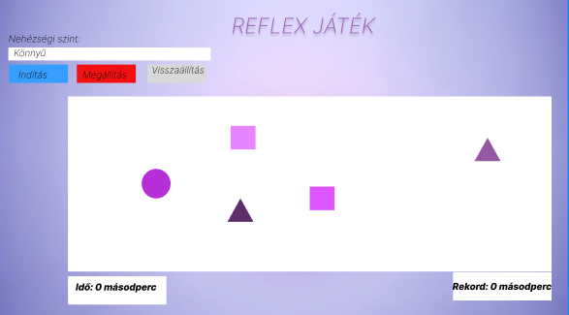
Design Process

Slide 6
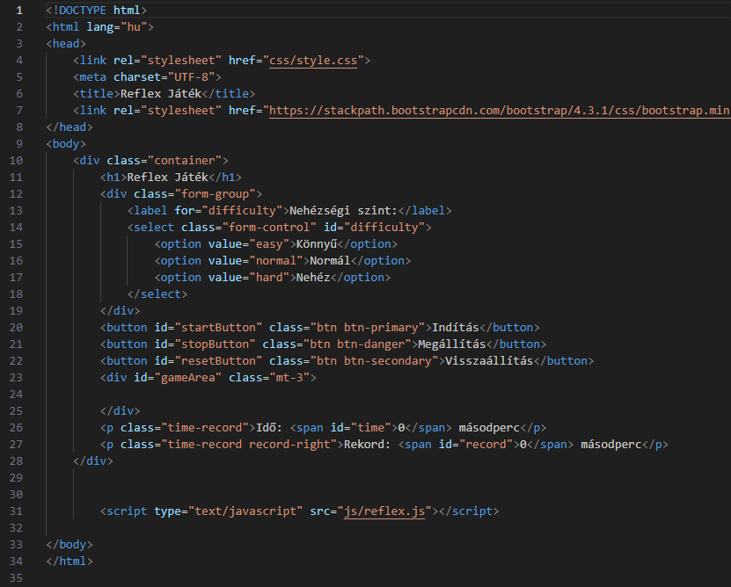
HTML

Slide 7
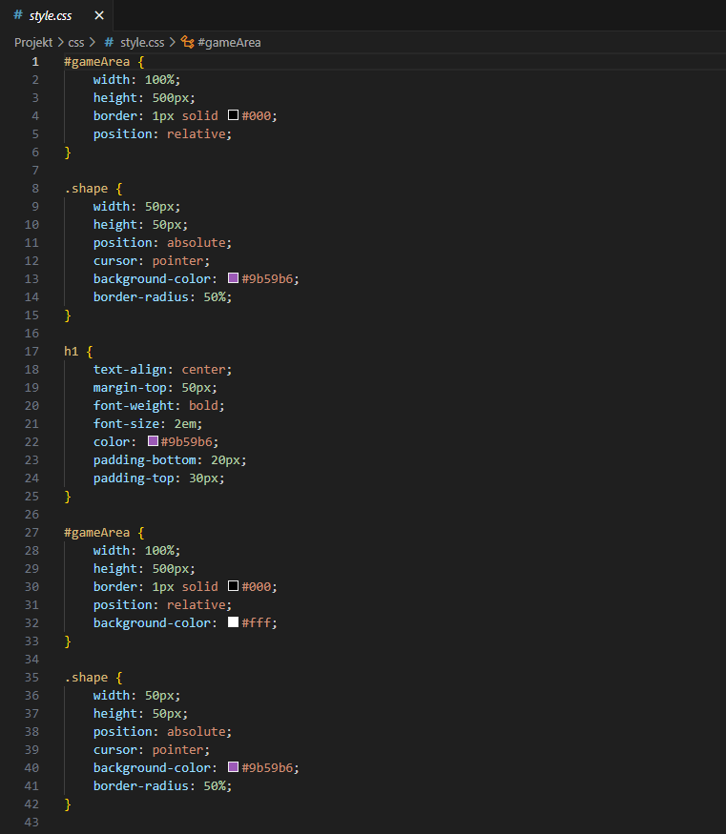
Css

Slide 8
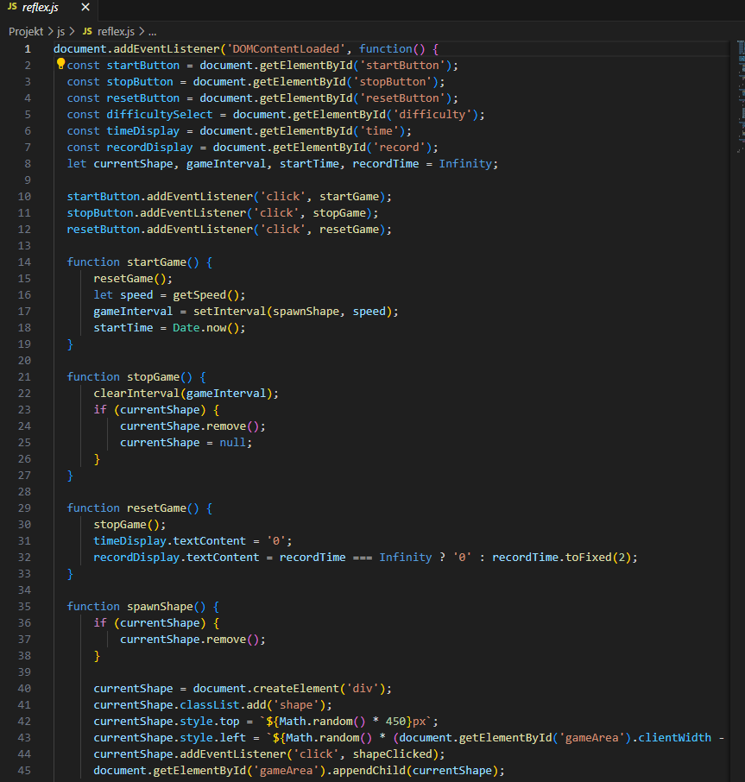
Js

Slide 9
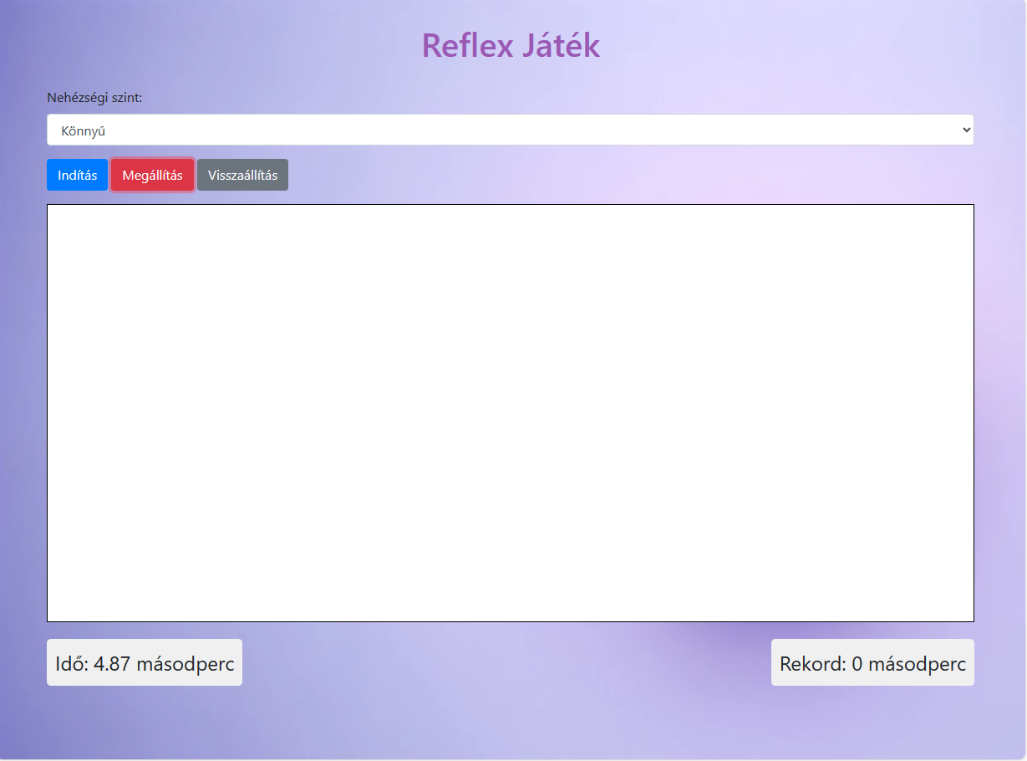
Game

Slide 10
Balogh Ádám – project leader
Dunai Krisztián – programmer
Kispál Marcell – ppt in hungarien
Jakab Máté – ppt in english

Slide 11
Thanke you for your attention!

